Slide 1



THREE IMPORTANT OBJECTS OF HIBERNATE
Chapter 3

Slide 2
Today’s Agenda
In Depth Understanding Of Hibernate
Hibernate’s Built-In Objects
Three Special Objects Of Hibernate
Details Of These Three Objects
Creating These Three Objects

Slide 3
Hibernate Built In Objects
We know that the main role of Hibernate is to perform ORM .
It is there to purely perform object based persistence logic.
Although we use POJO/Entity/Persistent class objects to write those persistence logic but to use these POJO classes we need some other objects provided by Hibernate.

Slide 4
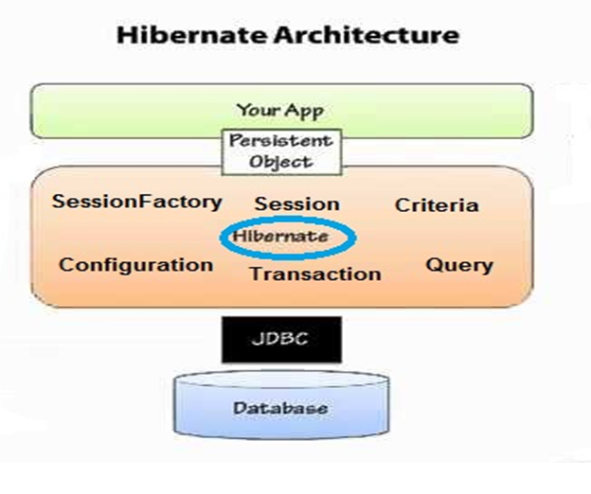
Hibernate Built In Objects

Slide 5
Three Special Objects
Amongst all these objects , three objects are very important and they are:
The Configuration Object
The SessionFactory Object
The Session Object

Slide 6
The Configuration Object
It is the object of the class org.hibernate.cfg.Configuration.
It’s main responsibility is to activate or bootstrap hibernate framework by using hibernate provided jar files.
It reads both the configuration file and mapping file data .
Verifies that these files are well formed and valid.

Slide 7
The Configuration Object
If they are , then it prepares an in-memory metadata .
Metadata means , it takes the details given in both the xml files and adds some more details ,saves these details in application’s memory inside the Configuration object

Slide 8
The Configuration Object
Advantage of Metadata:
Improves application performance.
If our Hibernate code needs to interact with the DB 100 times , then it will be very time consuming for it to read xml files 100 times , validate them 100 times etc.
So to make this process smooth and make our application run faster , the in memory metadata is prepared

Slide 9
Code To Create Configuration Object
Configuration cfg=new Configuration();
// will activate hibernate
cfg=cfg.configure(“myconfig.cfg.xml”);
//will read both the xml files and prepares metadata
If we do not pass any argument then the configure() method will
automatically take the default file name as hibernate.cfg.xml

Slide 10
The SessionFactory Object
It is the object of the class implementing the interface org.hibernate.SessionFactory.
It’s main responsibility is to create and return Session objects , that’s why it is called SessionFactory.
A Session object in hibernate framework is just like a Connection object of JDBC

Slide 11
The SessionFactory Object
The SessionFactory object is created by Configuration object which reads the configuration file and mapping file data and creates different services like connection pooling , dialect , Transaction manager , OR-mapping etc
It then uses these services to finally build a SessionFactory object.
This way of creating an object is called Builder Design Pattern

Slide 12
What Is A Connection Pool ?
Connection pooling is a technique to open/prepare/close connections.
A connection pooling mechanism is a piece of software (component), to which we delegate the responsibility of managing connections.

Slide 13
What Is A Connection Pool ?
Our application would just ask for a connection, use it, and deliver it back to the pool.
The component is responsible for opening N connections and leave them ready for when our application asks.
This represents a better usage of connections, as we don't need to wait for the connection to be established during the actual execution of our code.

Slide 14
The SessionFactory Object
Other important points about this object are that it is a Heavy Weight object because it contains all the metadata information from Configuration object , maintains connection pool and thus consumes lot of resources and time
Thus it is created only once in our hibernate application.
Moreover it is immutable also , i.e. once created we cannot change it’s contents.

Slide 15
The SessionFactory Object
And since it is immutable , it is also considered to be thread-safe
It’s main responsibility is to create and return Session objects , that’s why it is called SessionFactory.
To create a SessionFactory object we call the instance method called buildSessionFactory() of the Configuration object

Slide 16
Code To Create SessionFactoryObject
SessionFactory sf=cfg.buildSessionFactory();
// the above code will create a SessionFactory object and return it.

Slide 17
The Session Object
It is the object of the class implementing the interface org.hibernate.Session.
It is created and returned by the SessionFactory object
It maintains a session/connection to the DB.
It’s main responsibility is to allow programmers to perform CRUD operations on the DB and thus it is the central interface between our program and the database.

Slide 18
The Session Object
It provides us methods like save( ), update( ), get( ), delete( ) etc for performing ORM operations in our code.
It is a short-lived object representing a conversation between the application and the persistent store.
Also it is not thread-safe so it must be created and destroyed as and when needed

Slide 19
Code To Create Session Object
Session s=sf.openSession();
// the above code will create a Session object and return it.

Slide 20
Few Important Methods Of Session Object
save(): Save() method generates the primary key and inserts the record in the database.
update():Update() is used to update the existing database record.
delete(): Delete method works in persistent mode to remove the entity from the database.
get(): Returns the persistent instance of the given entity class with the given identifier

